Slide 1
China Banking Monitor
March 15, 2023

Slide 2
Index
01
Macroeconomic environment
02
Banks’ performance amid the slowing economy
03
Property market weaknesses pose risks for banks
04
Banks interconnectedness with shadow banking systems

Slide 3
Main takeaways
Aggregate credit growth remained subdued in 2022 amid a slowing economy, while new bank lending rebounded to a record high in January 2023 thanks to the exit of Zero COVID policy.
Bank assets growth saw a faster expansion in response to regulators’ renewed call for more credit support to corporate borrowers.
Despite of the lower funding costs, banks’ profitability is weighed by narrowing interest rate margins amid a challenging operating environment.
The NPL ratio declined as banks’ sustained disposal of bad loans. However, non-performing loan formation remains a major source of risk to asset quality.
Capital adequacy ratio remained stable, but needs more capital to support its forthcoming credit spree. Small lenders are still subject to capital shortfalls.
Although bank’s exposure to the housing sector is declining, the risks associated with property market could exacerbate the debt overhang problem.
Banks interconnectedness with the shadow banking system continue to diminish.

Slide 4
Macroeconomic environment
01
Weaker-than-expected credit growth in 2022 amid a slowing economy

Slide 5
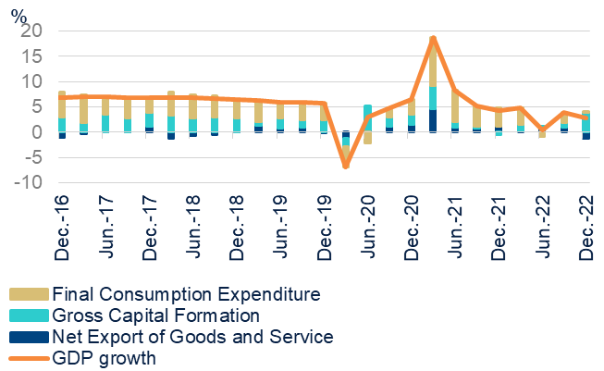
A bumpy V-shape recovery amid disordered “Zero covid” relaxation
GROWTH SLOWED TO 2.9% IN Q4 FROM 3.9% IN Q3, CONCLUDING 2022 GDP AT 3.0%
WEAK REAL ESTATE FAI STILL WEIGHED ON FAI, WHILE INFRASTRUCTURE FAI PICKED UP
Source: CEIC & BBVA Research.
Source: CEIC, Haver & BBVA Research
The economic growth slowed to 2.9% y/y in Q4 from 3.9% y/y in Q3, concluding 2022 GDP at 3.0%, amid a number of headwinds including weak consumer demand, intermittent COVID-related mobility restrictions and beleaguered property market.

Slide 6
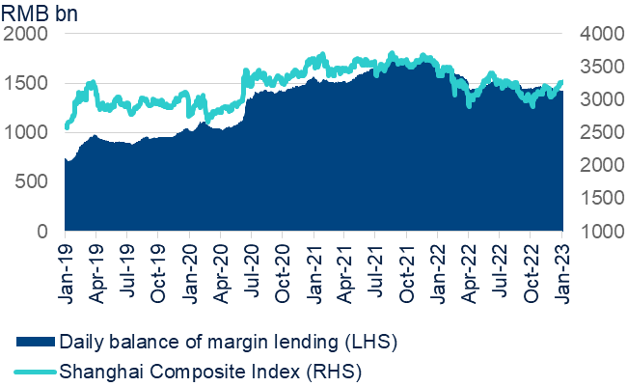
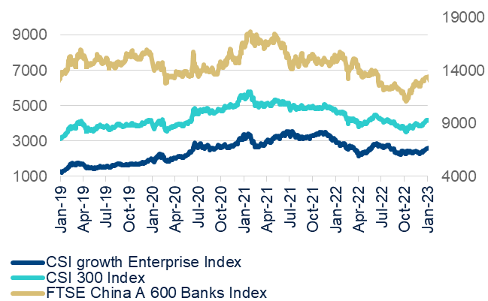
China’s stock market remained sluggish in 2022 but saw a pick up after the economy reopened
SHANGHAI COMPOSITE INDEX GOT A BOOST FROM THE EXIT OF ZERO COVID POLICY
…AS WELL AS CSI 300 INDEX AND FTSE CHINA A600 BANKS INDEX
Source: Wind & BBVA Research
Source: Wind & BBVA Research
China’s abrupt exit of Zero Covid policy gave rise to a stock market rally. In the aftermath of China’s reopening, both the Shanghai Composite Index and CSI 300 index revised their previously declining trend.

Slide 7
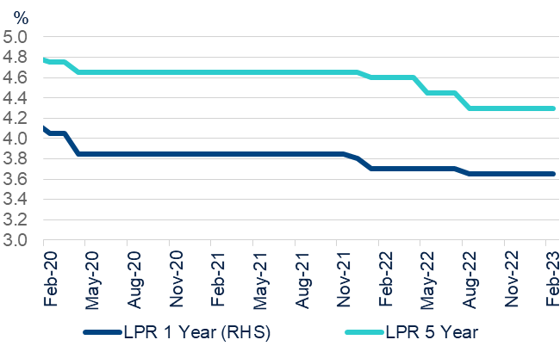
Easing monetary policy to accommodate growth to prevent growth hard-landing
HOEVER, THE PBOC MAINTAINED LPR AFER AUGUST’S CUT AMID AGGRESSIE FED HIKE
THE CENTRAL BANK HAS CUT RRR 2 TIMES IN APRIL AND DECEMBER RESPECTIVELY IN 2022
Source: Haver & BBVA Research
Source: CEIC & BBVA Research
The central bank cut the 5-year loan prime rate, a reference interest rate for mortgages, twice in 2022. In addition, the central bank cut 1-year loan prime rate in August and cut reserve requirement ratio for banks twice during the past year.

Slide 8
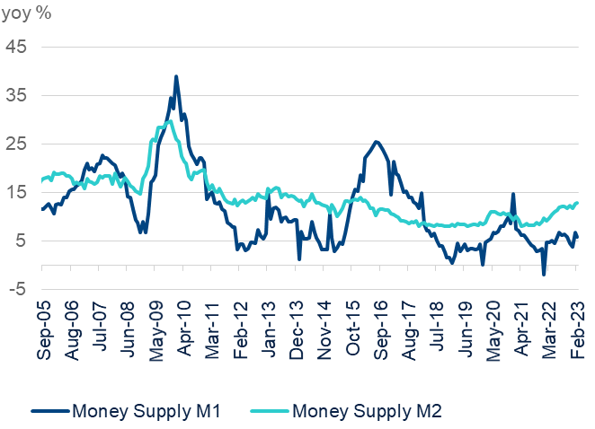
Credit growth remain subdued in 2022 amid a slowing economy but rebounded quickly in 2023
TOTAL SOCIAL FINANCING REBOUNDED IN 2013 AMID THE ECONOMY RECOVERY
…SO DID M2 GROWTH RATE
Source: CEIC & BBVA Research
Source: Wind & BBVA Research
Growth of outstanding total social financing (TSF), a broad measure of credit and liquidity in the economy, slowed to single digit growth at 9.6% in December 2022. However, new bank lending set a record high to RMB 4.9 trillion and 1.8 trillion in Jan and Feb 2023 respectively, in response to the central bank’s call to support the COVID-ravaged economy.

Slide 9
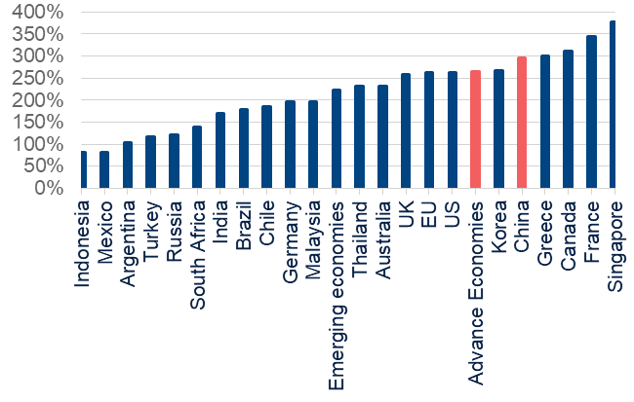
China’s debt overhang concentrates on local government debt and corporate debt
CHINA’S MACRO LEVERAGE RATIO REACHED 295.3% TILL Q2 2022
CHINA’S MACRO LEVERAGE RATIO IS HIGHER THAN EMERGING MARKETS AVERAGE
Source: CEIC & BBVA Research
China’s macro leverage ratio, defined as total debt as % of GDP, rose to the record high of 295.9% at Q3 2022, 9.2% points higher than the same period last year. However, the debt overhang issue mainly focus on corporate debt and local government debt, while homebuyers are rushing to pay down mortgages as banks lowered mortgage rates.

Slide 10
Performance of banking Sector
02
Asset quality is subject to headwinds

Slide 11
A snapshot of financial fundamentals of Chinese banks
 | 2020 Q3 | 2020 Q4 | 2021 Q1 | 2021 Q2 | 2021 Q3 | 2021 Q4 | 2022 Q1 | 2022 Q2 | 2022 Q3 | 2022 Q4
Asset quality and credit risk
Loans/total assets | 53.7% | 54.0% | 54.7% | 55.2% | 55.8% | 55.9% | 56.2% | 56.1% | 56.4% | 56.4%
NPL ratio | 1.96% | 1.84% | 1.80% | 1.76% | 1.75% | 1.73% | 1.69% | 1.67% | 1.66% | 1.63%
(NPL+special-mention loan) ratio | 4.41% | 4.41% | 4.22% | 4.12% | 4.11% | 4.06% | 4.00% | 3.98% | 3.93% | 3.86%
Provisions/NPLs | 179.9% | 184.5% | 187.1% | 193.2% | 197.0% | 197.0% | 200.7% | 203.8% | 205.5% | 205.9%
Profitability & efficiency
NIM | 2.09% | 2.10% | 2.07% | 2.06% | 2.07% | 2.08% | 1.97% | 1.94% | 1.94% | 1.91%
Cost to income ratio | 28.1% | 31.2% | 27.1% | 28.1% | 29.0% | 32.1% | 27.7% | 28.9% | 30.0% | 34.0%
ROE | 10.1% | 9.5% | 11.3% | 10.4% | 10.1% | 9.6% | 10.9% | 10.1% | 9.3% | 9.3%
ROA | 0.80% | 0.77% | 0.91% | 0.83% | 0.82% | 0.79% | 0.89% | 0.81% | 0.75% | 0.76%
Solvency
Tier 1 ratio | 11.7% | 12.0% | 11.9% | 11.9% | 12.1% | 12.4% | 12.3% | 12.1% | 12.2% | 12.3%
Core Tier 1 | 10.4% | 10.7% | 10.6% | 10.5% | 10.7% | 10.8% | 10.7% | 10.5% | 10.6% | 10.7%
Leverage ratio | 6.7% | 6.9% | 6.9% | 6.9% | 7.0% | 7.1% | 7.0% | 6.8% | 6.8% | 6.9%
NPLs/ Capital | 11.9% | 11.0% | 11.1% | 10.9% | 7.0% | 10.4% | 10.3% | 10.4% | 10.3% | 10.1%
Liquidity and funding
Deposits/Total assets | 67.0% | 68.3% | 68.9% | 69.4% | 69.4% | 80.5% | 80.5% | 80.9% | 80.9% | 80.8%
Non-deposits funding (Central bank, bonds, NCDs, ...) / Total assets | 37.2% | 37.7% | 37.4% | 37.6% | 38.1%
Loan to deposit ratio | 75.5% | 76.8% | 77.2% | 78.1% | 79.1% | 79.7% | 78.7% | 78.4% | 78.7% | 78.8%
Liquidity coverage ratio | 138.7% | 146.7% | 141.8% | 141.2% | 142.2% | 145.3% | 143.2% | 146.3% | 142.7% | 147.4%
Source: CEIC & BBVA Research.

Slide 12
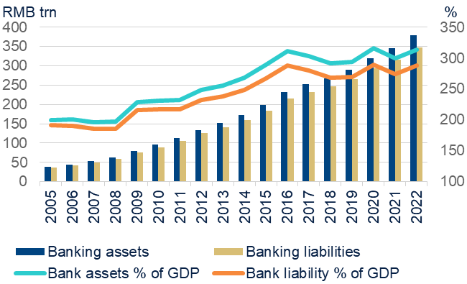
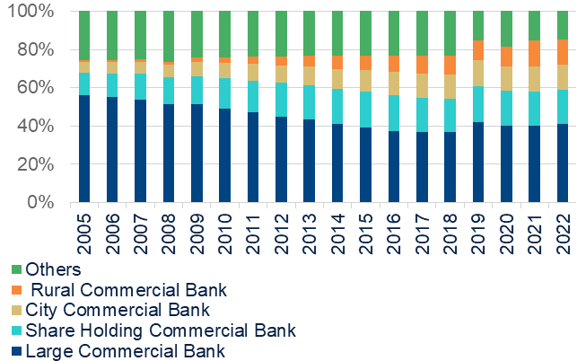
Bank assets growth saw a faster expansion in the first three quarters of 2022
BANKING ASSETS ACCELERATED ITS GROWTH RATE
LARGE AND SHAREHOLDING COMMERCIAL BANKS STILL DOMINATE IN BANKS’ ASSETS
Source: CBIRC & BBVA Research
Source: CBRIC & BBVA Research
China’s banking sector assets accelerated to 10.0% in 2022 (RMB 379.4 trillion) compared to just 7.8% in the previous year (RMB 344.8 trillion), in response to regulators’ renewed call for more credit support to corporate borrowers. Moreover, our breakdown data showed that large and share-holding banks jointly accounted for 69.4% of the total commercial banks’ assets.

Slide 13
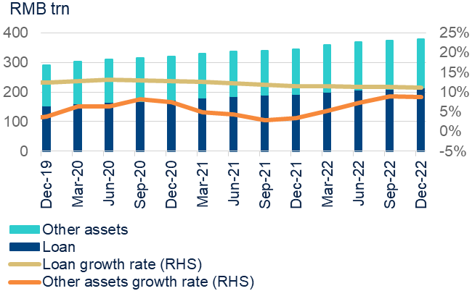
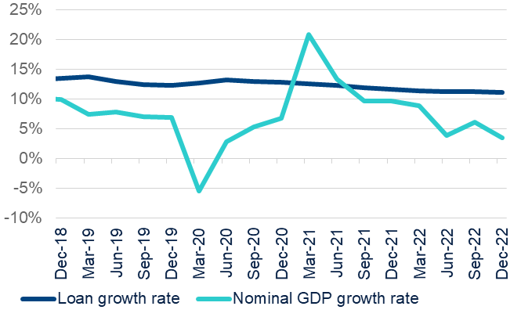
Loan growth moderate slightly while non-loan assets growth picked up
LOAN ASSETS GROWTH CONTRIBUTED TO THE BANKING ASSET EXPANSION
…AND LOAN GROWTH RATE STILL EXCEED NOMINAL GDP GROWTH RATE
Source: CEIC & BBVA Research
Source: CEIC & BBVA Research
Loan growth came out at 11.1% in 2022 compared with 11.5% in 2021. In contrast, the growth of non-loan assets jumped to 8.8% in 2022 from 2.8% in 2021, driven by increasing bond purchase and interbank activities.

Slide 14
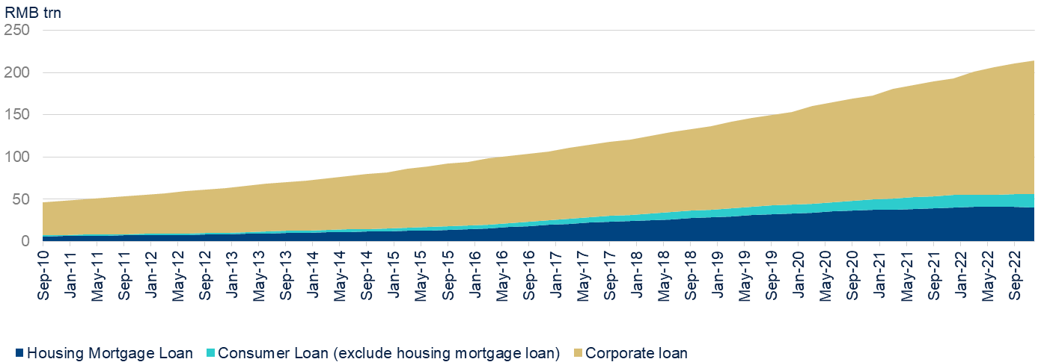
Housing mortgages and retail loans weighed on loan growth rate
Source: CEIC & BBVA Research
Consumer loan growth has tumbled to 5.7% y/y in 2022, as consumption activities and housing mortgage loan demand were severely affected by pandemic-related restrictions. In contrast, corporate loans jumped to 14.6% in 2022, thanks to government’s call for boosting the real economy through more lending to infrastructure, manufacturing ,”green” finance and SMEs.

Slide 15
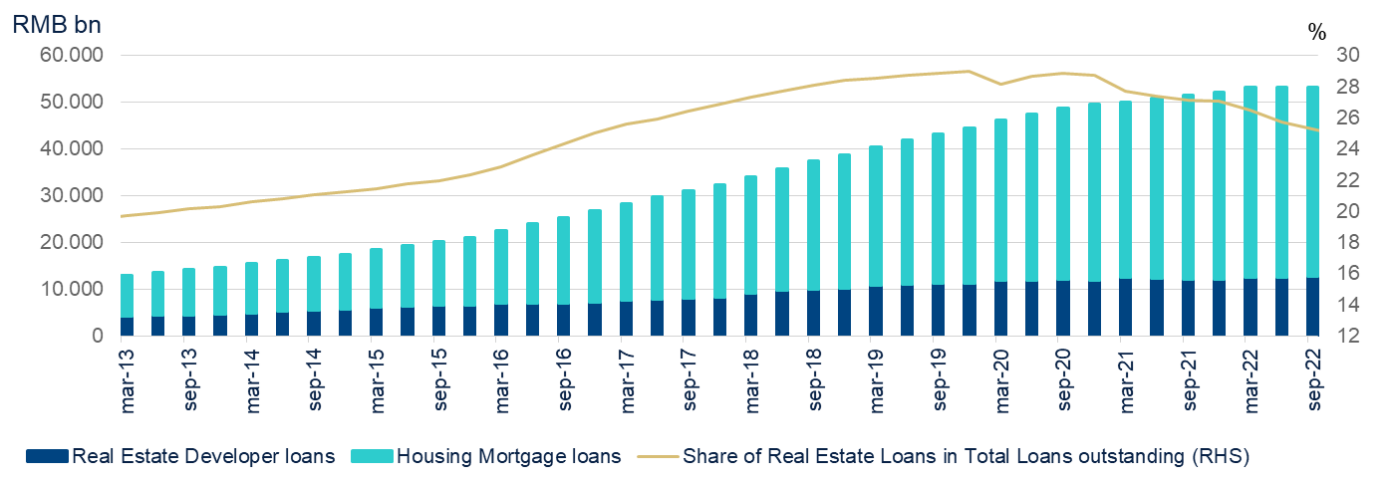
Bank’s exposure to housing sector was trending down
Source: CEIC & BBVA Research
China’s banking sector’s aggregate loans to real estate sectors (mortgage loans plus real estate developer loans) have slowed down to 24.8% from its peak level of 29%, as banks remain cautious towards new property exposures.

Slide 16
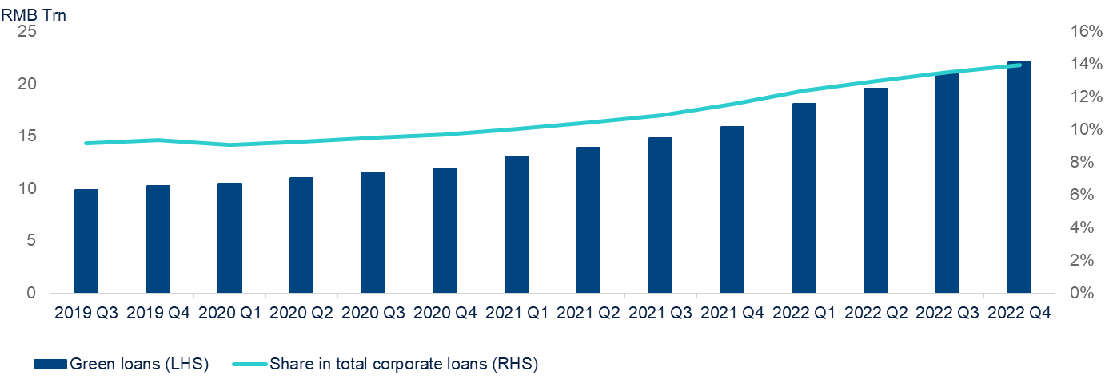
By contrast, green loan growth accelerated
Source: CEIC & BBVA Research
In response to the national priority of carbon neutrality initiative, banks are accelerating lending and investment in green projects including renewable energies, electric vehicles and new infrastructure etc. Consequentially, green loan growth accelerated to 38.6% at end 2022 and this trend is likely to maintain in 2023.

Slide 17
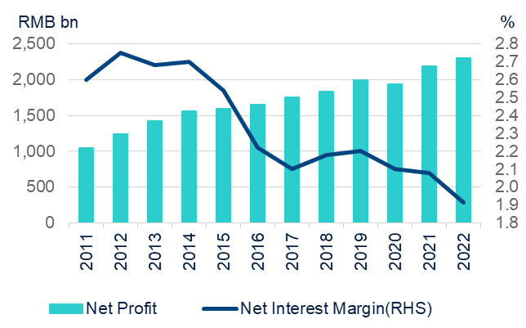
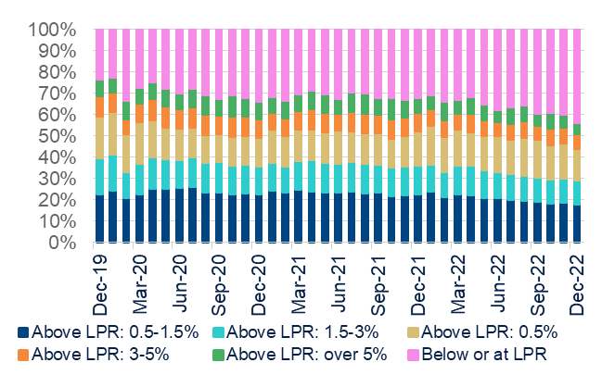
Banks’ profitability was under pressure due to narrowed interest rate margin
NET INTEREST MARGIN (NIM) SEE FURTHER DECLINES
THE PROPORTION OF LENDING RATE BELOW OR AT LPR CONTINUES TO RISE
Source: CBRIC & BBVA Research
Source: CBRIC & BBVA Research
China’s banking sector assets accelerated to 10.0% in 2022 (RMB 379.4 trillion) compared to just 7.8% in the previous year (RMB 344.8 trillion), in response to regulators’ renewed call for more credit support to corporate borrowers. Moreover, our breakdown data showed that large and share-holding banks jointly accounted for 69.4% of the total commercial banks’ assets.

Slide 18
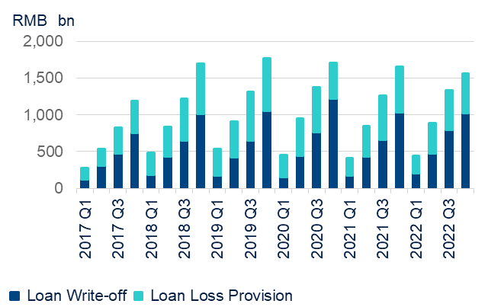
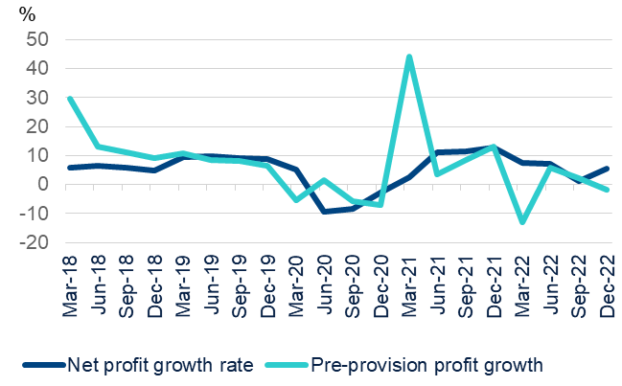
Bank’s provisions for bad loans have moderately slightly
BAD LOAN RESOLUTION REMAIN SUSTAINED WHILE LOAN LOSS PROVISION DECLINED
BANKS’ PRE-PROVISION PROFIT GROWTH RATE WERE BELOW THAN NET PROFIT GROWTH RATE
Source: CBRIC & BBVA Research
Source: CBRIC & BBVA Research
The executive meeting of the State Council held on April 2022 encouraged large banks with relatively high provision levels to reduce their provision coverage ratios in an orderly manner to channel the fund to support the real economy. As a result, banks’ provisions for bad loans have moderated to RMB 534.3 compared with RMB 622.5 the same period last year.

Slide 19
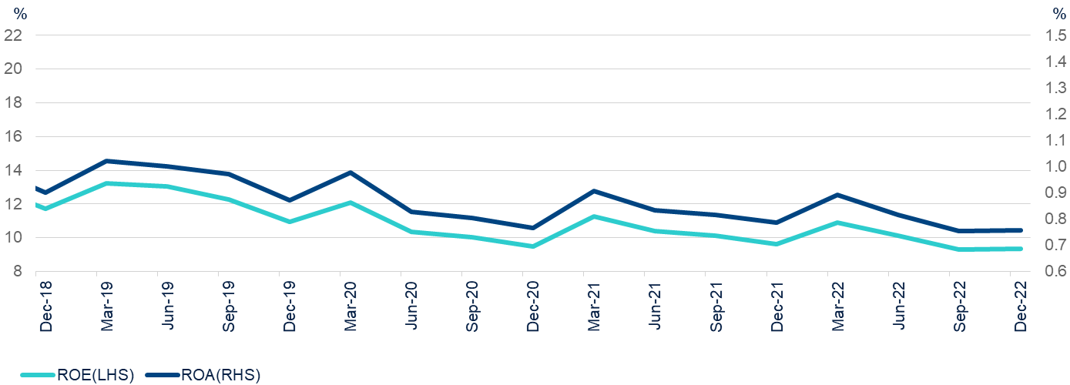
ROA and ROE registered the lowest record in more than 10 years
Source: CBRIC & BBVA Research
Both ROE and ROA dropped to 9.3% and 0.76% respectively in 2022, registering their lowest levels in more than a decade. In particular, the ROE and ROA for large and share-holding commercial banks stayed broadly flat as they benefited from lower market interest rates. However, city and rural banks had to pay higher funding costs for ever-intensifying deposit competition.

Slide 20
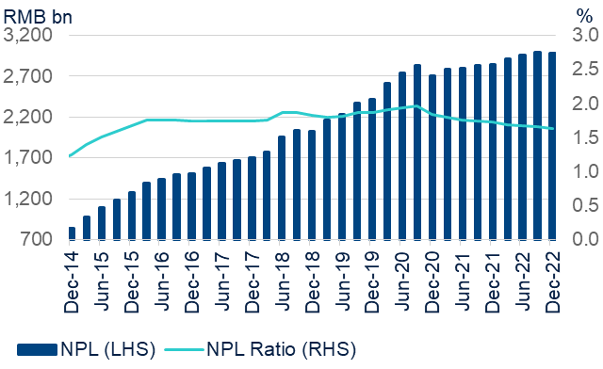
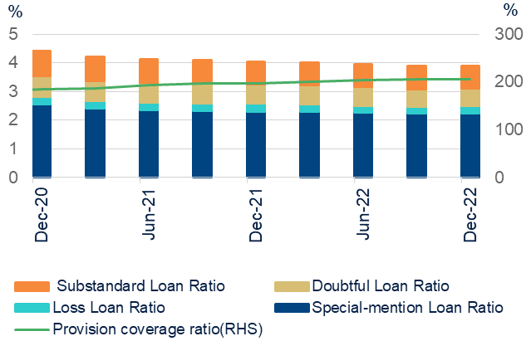
Although both NPL ratio and special-mention loan ratios declined due to a sustained NPL disposal, asset risks are rising
NPL RATIO MODERATED WHILE NPLS LEVEL REMAINED HIGH
…SPECIAL- MENTION LOAN RATIO ALSO DECLINED AS CONTINUOUS DISPOSAL OF BAD LOANS
Source: CEIC & BBVA Research
Source: CEIC & BBVA Research
Both the NPL ratio and special-mention loan ratios edged down slightly to 1.63% and 2.25% respectively in the Q4 2022 from 1.73% and 2.31% respectively a year ago, supported by a sustained effort in NPL disposal. However, new nonperforming loan formation remains a major source of risk to asset quality.

Slide 21
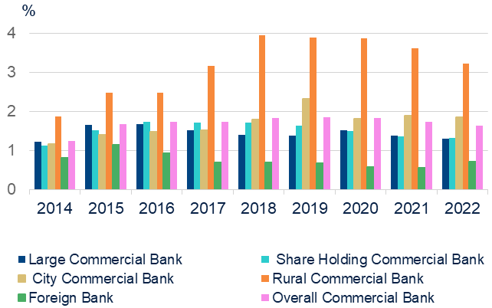
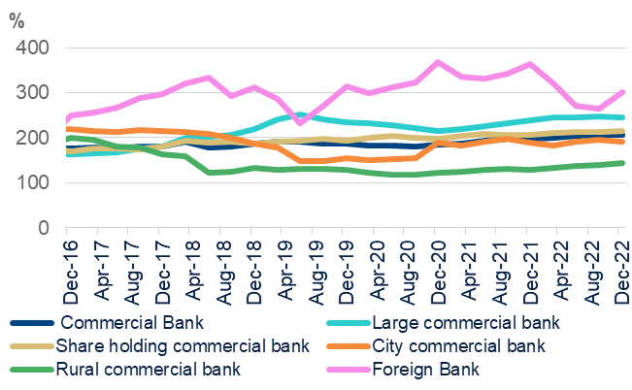
Loan quality diverged between big banks and regional banks
RURAL COMMERCIAL BANKS ARE VULNERABLE TO FURTHER ASSET DETERIORATION (NPL RATIO %)
THE PROVISION COVERAGE RATIO FOR RURAL COMMERCIAL BANKS IS UNDER THE REGULATORY REQUIREMENT
Source: CEIC & BBVA Research
Source: CEIC & BBVA Research
Rural and city commercial banks are still vulnerable to further asset quality deterioration given their less diversified asset portfolios and higher exposure to real estate. In particular, rural commercial banks collectively have a provision coverage ratio of about 143.2%, which is lower than the upper bound of supervisory requirement of 150%.

Slide 22
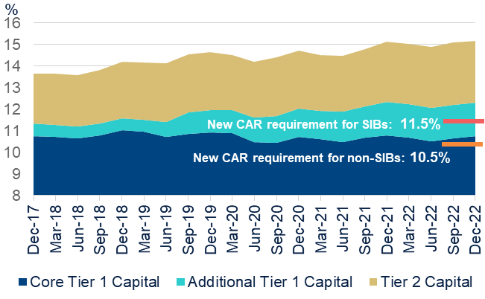
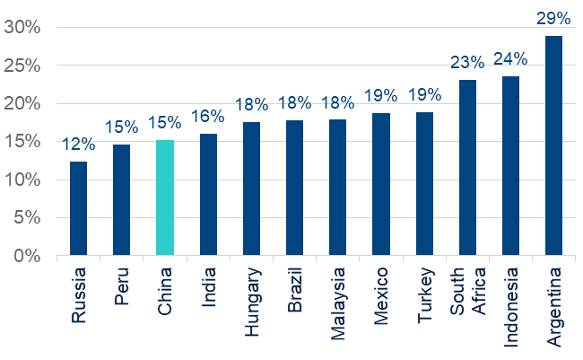
Banks’ capitalization remained stable, but needs more capital to support its forthcoming credit spree
CORE TIER 1 CAPITAL ADEQUACY RATIO HAS DECLINED SIGNIFICANTLY
AND CHINESE BANKS’ CAR STILL LAG BEHIND THEIR MAJOR EMS PEERS
Source: CEIC & BBVA Research
Source: CEIC & BBVA Research
Bank capitalization remained stable, while the core tier 1 capital ratio edged down to 10.7% at end-2022, 1 basis points lower than a year ago. Meanwhile, additional tier 2 capital ratio rose by 9 basis points over the same period, driven by the issuance of perpetual bonds.

Slide 23
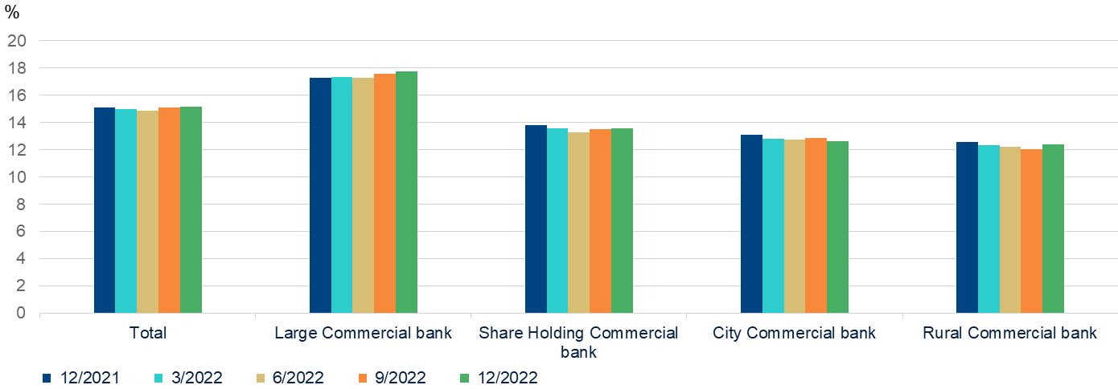
A diverged capital buffer distribution among big and smaller banks
Source: CBRIC & BBVA Research
City and rural commercial banks have lower capital adequacy ratios due to their larger exposure to the property sector as well as their higher sensitivities of funding costs.

Slide 24
China to build differentiated capital regulatory system for banks
BANKS ARE CLASSIFIED INTO THREE BUCKETS BASED ON BUSINESS SCALE AND RISK LEVEL
Classification | Assets size (including on and off balance sheet) | Cross-boarder exposures | Capital regulatory measures | Intentions
Tier 1 | Over or equal to RMB 500 billon | Over or equal to RMB 30 billon | In line with international standard to disclose a complete set of reports | Enhance the risk sensitivity of large banks capital management and improve the comparability of their capital ratios and public disclosures in a global context.
Tier 2 | Over or equal to RMB 10 billon | Below RMB 30 billion | Subject to relatively simplified capital regulatory measures | Reduce compliance costs for middle and small banks to serve the real economy.
Tier 3 | Less than RMB 10 billon | Not involved in any cross-boarder business | Simplify capital requirements although not lower standard | Facilitate them in better serving the county economy as well as small and micro businesses.
Source: China Banking and Insurance Regulatory Commission & BBVA Research
The CBIRC and PBoC jointly issued the amended draft rules for consultation on the revised capital measures on 26th Feb 2023. The new regulation will put differentiated supervision on bank capital to reduce compliance costs for small and medium-sized banks, and improve banks’ ability to serve the economy. The new rule is expected to be implemented in Jan 2024.

Slide 25
Risks exposure rules are also refined
Summarised Risk Weights Revisions under Standardised Approach
Exposure type | Current rules in China |  | New rules (for consultation) | Final Basel III rules
Corporate exposure | Investment grade corporates | 100% | 75% | 65%
 | Small & medium-sized enterprises | 100% | 85% | 85%
 | Property development loans failing to meet specific prudential standards | 100% | 150% | 150%
Retail exposure | Residential mortgage (if not dependent on cash flows generated by the property) | 50% | 40% for LTV below 60%; 45% for LTV between 60% to 80% | 20% for LTV below 50%; 25% for LTV between 50%-60%; 30% for LTV between 60%-80%
 | Revolving retail loans to transactors* | 75% | 45% | 45%
Exposure to banks | Senior debts with maturities over three months | 25% | 30% for Grade A+ banks** 40% for Grade A banks*** | 30% for Grade A+ banks 40% for Grade A banks
Exposure to non-central government-related public sector entities | Subordinated debt & capital instruments | 100% | 150% | 150%
 | Local government general bond | 20% | 10% | 0%-50% for public sector entities within sovereigns rated at A- category or higher***, subject to discretion at local authorities
Note: *Transactors are obligors in relation to facilities such as credit card where the balance has been repaid in full at each scheduled repayment date for the latest 12 months in the past 3 years. **Grade A banks are those with adequate capacity to meet their financial commitments in a timely manner irrespective of the economic cycles and business conditions, and must meet or exceed the published minimum regulatory requirements and buffers established by its national supervisor. ***Grade A+ banks are subject to an additional requirement of having a CET1 ratio meeting or exceeding 14% and a Tier 1 leverage ratio meeting or exceeding 5% on top of the requirements for Grade A banks. ****0%-20% for those in AA-category sovereigns.
Source: Fitch Ratings, China Banking and Insurance Regulatory Commission & BBVA Research
The exposure to local government bonds and high-quality corporate borrowers are subject to less capital charge while the exposure to interbank activities .are subject to more capital charges. In sum, the overall level of capital adequacy ratio in the Chinese banking sector will remain stable under new rules.

Slide 26
China’s global systemically important banks face TLAC shortfall
RELATIONSHIP BETWEEN TLAC AND BASEL III
Base III
framework
TALC
framework
TALC & Basel III
framework
Capital buffers
3.5%-8.5%
Capital conservation,
countercyclical and other G-SIB buffers
Equal to or greater than 33% of minimum TLAC requirement
Minimum capital requirement
8.0%
TLAC requirement & Capital buffers
19.5%-26.5%
Capital adequacy
Ratio 8%
Tier 1
capital
Ratio 6%
Core tier 1 capital 4.5%
Basel Capital Requirements
TLAC Requirements
TLAC requirement & Capital Buffers
Capital conservation, countercyclical and other G-SIB buffers
Unsecured, subordinated and other eligible debt
Tier 2 capital
Core tier 1 capital
Additional tier 1 capital
Source: FSB & BBVA Research
The capital shortage major banks faced will be accelerated in the next few years to meet the TLAC rule, which will be implemented at the start in 2025, with a higher requirement taking effect in 2028. It is expected that the top 4 Chinese banks will need to raise RMB 3.8Tn in capital to meet the regulation needs in 2025.

Slide 27
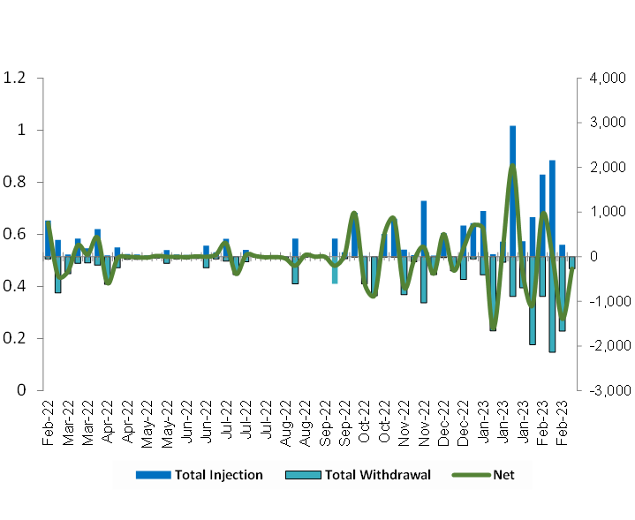
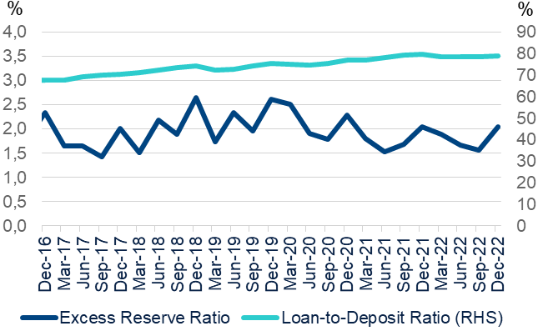
Banks’ liquidity remained adequate
CHINA PBOC ACCELERATED OPEN MARKET OPERATIONS IN THE SECOND HALF YEAR
EXCESS RESERVE INDICATES THAT LIQUIDITY IN THE BANKING SYSTEM REMAIN ADEQUATE
Source: Bloomberg & BBVA Research
Source: CBRIC & BBVA Research
The PBOC has accelerated the pace of net liquidity injection given the slow economic growth during 2022. Excess reserve ratio remained at 2.1% in Q4 2022, 10 basis points higher than a year ago, indicating that liquidity in the banking system remain adequate after the PBOC cut the RRR and benchmark interest rate.

Slide 28
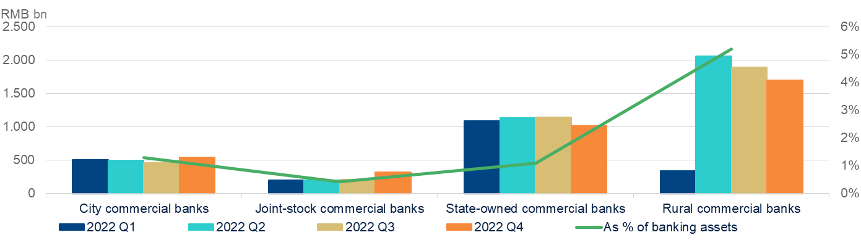
Small banks’ reliance on negotiable certificates of deposits (NCDs) as funding source decreased
BALANCE OF COMMERCIAL BANKS ISSUED NCDs BY BANK TYPES
Source: Shanghai Clearing House & BBVA Research
Small banks reduced their reliance on interbank negotiable certificates of deposits (NCDs), which alleviated the concern that cross-holdings of bank securities among financial institutions will trigger crisis contagion during market distress.

Slide 29





Banking sector enter 2023 with greater headwinds
Asset growth is likely to continue its growth in 2023, albeit at a slower pace, as the government pushes large lenders to extend new credit to infrastructure and unfinished property projects. Loan growth will picked up next year as Chinese banks pledged billions in credit support to help struggling developers. Corporate lending is likely to dominate the sector’s loan growth in the 2023, while loan demand from households and the private sector is subject to uncertainties.
Asset growth
Banks’ NPL ratios will likely increase moderately in 2023 as asset risks are rising amid a deteriorating operation environment. Large banks have built strong loan loss reserves, while some smaller regional banks continue to be under more pressure as they have greater exposure to property-related businesses.
Asset quality
We expect banks’ profitability to underperform in 2023, as most banks have lowered corporate and mortgage loan lending rates amid the authorities’ call to lower companies’ and homebuyer’s funding cost. In addition, banks will continue to write off bad debts at a pace faster than before. The authorities will carefully manage the liquidity of interbank market, which can partially offset the adverse impact of narrowing net interest rate margin.
Profitability
Capitalization
Banks need to replenish capital through perpetual bond and equity issuance in support of their credit expansion.
Shadow banking
Shadow banking assets will retreat further amid strict regulatory supervision. Interconnectedness between banks and NBFIs is set to decline further in 2023.

Slide 30
Property market risks could exacerbate the debt overhang problem
03
The potential weakness in the real estate market posted risks for China’s financial institutions.

Slide 31
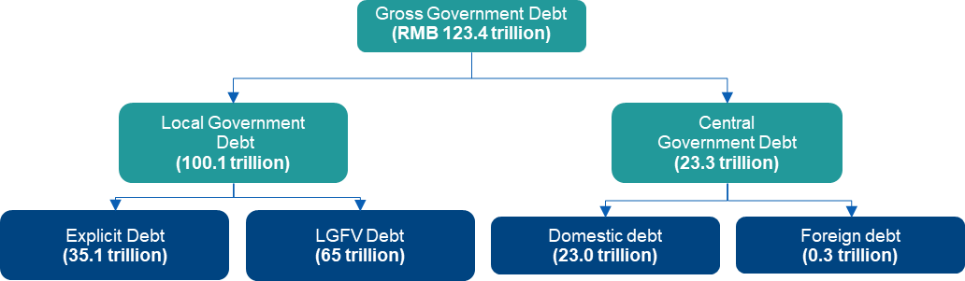
“Hidden debts” issued by the LGFVs debt will pose risks to the banking sector
Debt structure of China’s government debt by 1H 2022
Source: CBRIC, S&P rating, CEIC & BBVA Research
* The ”Hidden debt” issued by local government financial vehicles, entitles created to circumvent borrowing restrictions through borrow off-budget capital to facilitate local infrastructure and public projects.
China’s local government debt had already been rising dramatically for a decade before the pandemic, largely the result of a state-led investment boom in the wake of the 2008 global financial crisis. But the situation has largely deteriorated in the past several years.

Slide 32
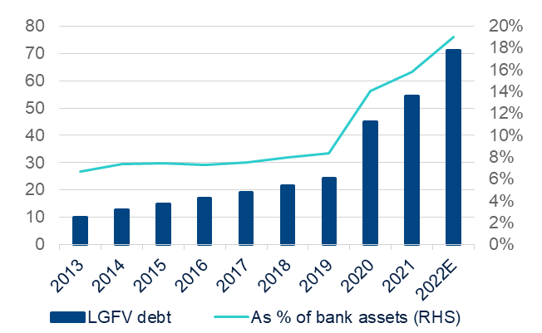
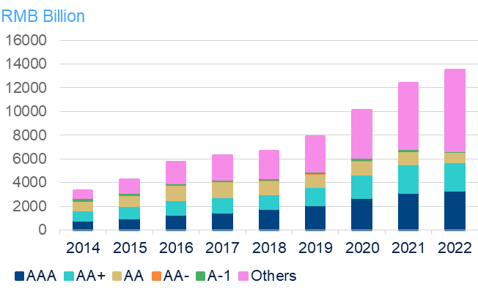
Local government debts have increased rapidly over the past several years
LOCAL GOVERNMENT DEBTS HAVE GROWN FAST IN THE PAST SEVERAL YEARS
DEFAULT RISKS AMONG WEAKER LOCAL GOVERNMENT FINANCING VEHICLES ARE RISING
Source: CBRIC, S&P rating, CEIC & BBVA Research
Source: PBoC & BBVA Research
It is estimated that the LGFVs totaled RMB 71 trillion by the end of 2022, or around 19 % of banking assets. China’s weaker LGFVs are facing higher risks of default and missed payments amid rising financing costs, a wave of maturities and a property crisis that is taking a toll on local authorities’ balance sheets.

Slide 33
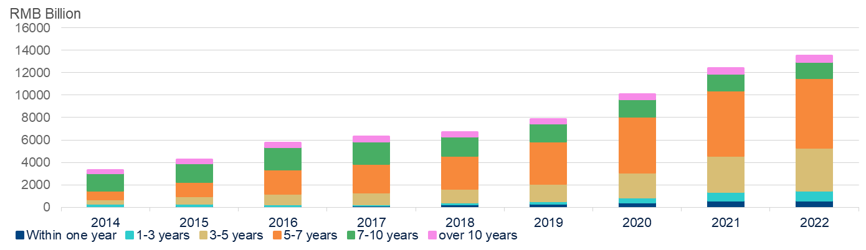
Most of LGFVs debt listed in stock exchange will mature in 5-7 years, while majority proportion of offshore debt will mature in 2 years
MOST OF LGFVS DEBT IN LISTED FIRMS WILL MATURE IN 5-7 YEARS
Source: Wind & BBVA Research
Most of LGFVs det in listed firms will mature in 5-7 years, while 84% of Chinese LGFV’s USD 84.2 billion of offshore debt will mature by 2025. Default risks among weaker local government financing vehicles have increased.

Slide 34
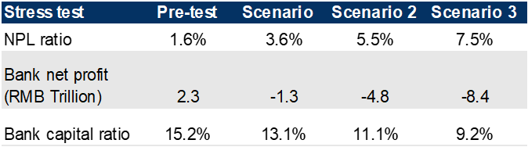

Stress test: LGFV debt default could impose financial risks
SOLUTIONS FOR SOLVING THE IMPLICIT LGFV DEBTS DEFAULT:
ASSUMPTIONS:
Scenario 1: 5% of LGFVs debts get defaulted.
Scenario 2: 10% of LGFVs debts get defaulted.
Scenario 3: 15% of LGFVs debts get defaulted.
STRESS TEST RESULT (RECOVERY RATE = 0):
Banks’ net profit will turn negative under all the above three scenarios. Banks need to set aside all of their net profit to write off the bad loans.
Banks NPL ratio will increase to 3.6% and 5.5% under scenario 1 and 2; banks NPL ratio will rise to 7.5% under scenario 3.
Bank’s capital adequacy ratio will drop to 13.1% and 11.1% respectively Under scenario 1 and 2 ; bank’s capital adequacy ratio will fall below the minimum requirement of 10.5% under the scenario 3.
Many measures could be used by defaulted LGFVs to repay the debt. i) Use annual budget funds, excess revenue, and revitalize financial stock funds to repay debts; ii) Transfer of government equity and operational state-owned assets; iii) Repayment through borrowing or roll-over debts; iv) Bankruptcy & liquidation.
Stress test:
Default risks among weaker local government financing vehicles have increased. The risk of idiosyncratic LGFVs defaults in weaker economic regions is rising, but the danger of systematic defaults remains low due to the importance of LGFVs for policy implementation and potential implications for the capital market.

Slide 35
Shadow banking activities
04
Banks interconnectedness with the shadow banking system has further decreased

Slide 36
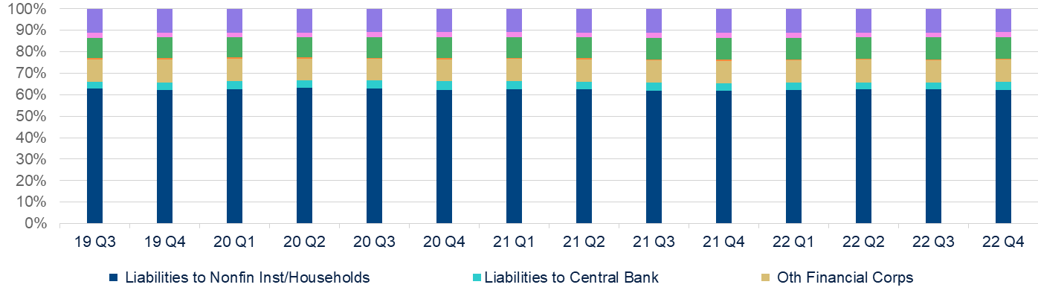
Banks’ fund dependence of shadow banking system has decreased moderately
BREAKDOWN OF BANKS LIABILITIES
Source: Haver & BBVA Research
Bank's reliance on other financial institutions has been reduced slightly This trend will likely continue in 2023 thanks to regulators efforts to guard against banks’ involvement in certain shadow banking and interbank activities. 2022 becomes the first years for banks to fully comply with new asset management regulations promulgated in 2018.

Slide 37
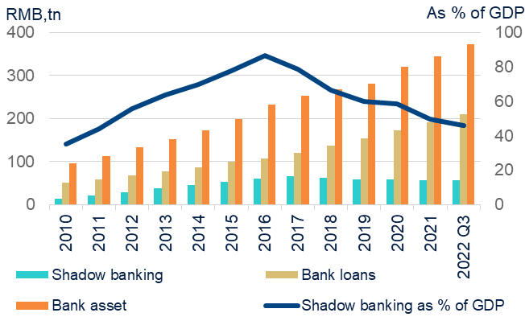
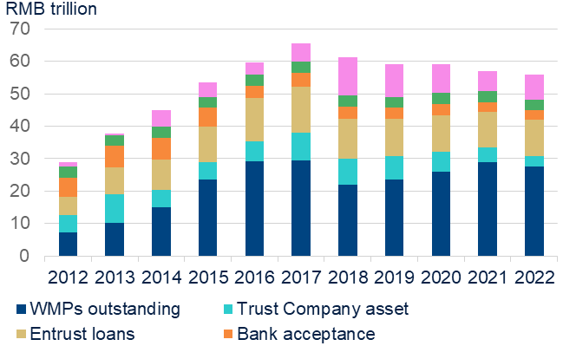
China shadow banking assets continued to trend down
SHADOW BANKING ASSETS AS % OF GDP CONTINUED TO TREND DOWN
THE DECLINE OF SHADOW BANKING SECTOR IS WEIGHED BY WEALTH MANAGEMENT PRODUCTS AND TRUST LOANS
Source: CBIRC, Moody & BBVA Research
The broad shadow banking assets continued their declining trend in the past 5 years, with total shadow banking assets moderating to RMB 55.9 trillion in Q3 2022 from RMB 57.6 trillion in the previous year, although at a slower rate. The contraction was mainly weighed by the decline in WMPs and trust loans.

Slide 38
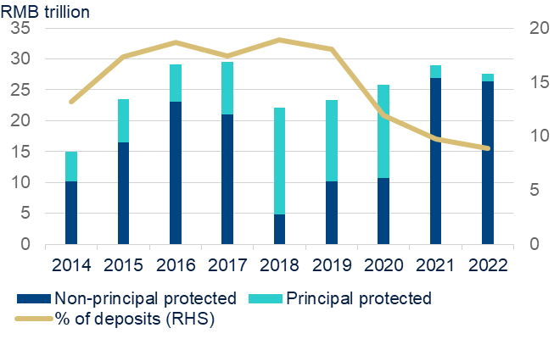
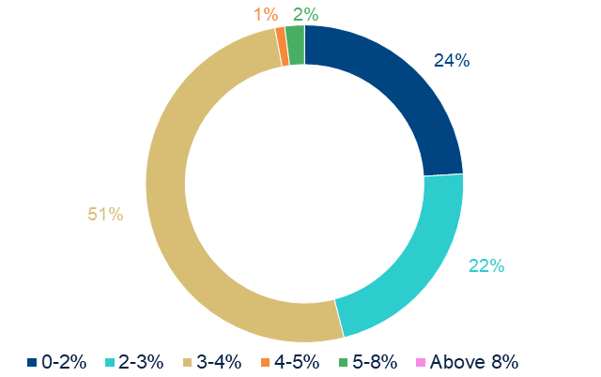
Interbank and non-standard wealth management products continue to shrink under enhanced regulatory efforts
PRINCIPAL PROTECTED WMPS OUTSTANDING HAS FURTHER DECLINED
THE YIELD OF WMPS CONTINUED TRENDING DOWN
Source: China Banking Wealth Management Market Annual Report & BBVA Research
Source: Wind & BBVA Research
*According to the WMPs that has published yield rate
WMPs, which used to act as a major funding channel for regional banks or highly leveraged companies, shrank to RMB 27.65 billion in the 2022 compared to RMB 29.0 trillion a year ago. More importantly, banks are not allowed to provide principal guarantees for issued WMPs under the new regulatory framework.

Slide 39
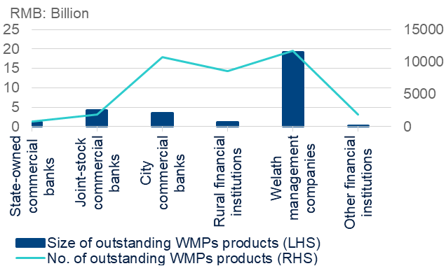
Maturity mismatch between WMPs and underlying assets has lessened
SHORT TERM WMPS OUTSTANDING HAS FURTHER DECLINED
BANKS ESTABLISHED WMP COMPANIES TO CONDUCT RELEVANT BUSINESSES SO AS TO RING FENCE ASSOCIATED RISKS
Source: Wind & BBVA Research
Source: China Banking Wealth Management Market Annual Report & BBVA Research
WMPs with short maturities (below 3 months) are relatively stable with their share around 40%, helping to reduce maturity mismatch risks between WMPs and underlying assets.

Slide 40
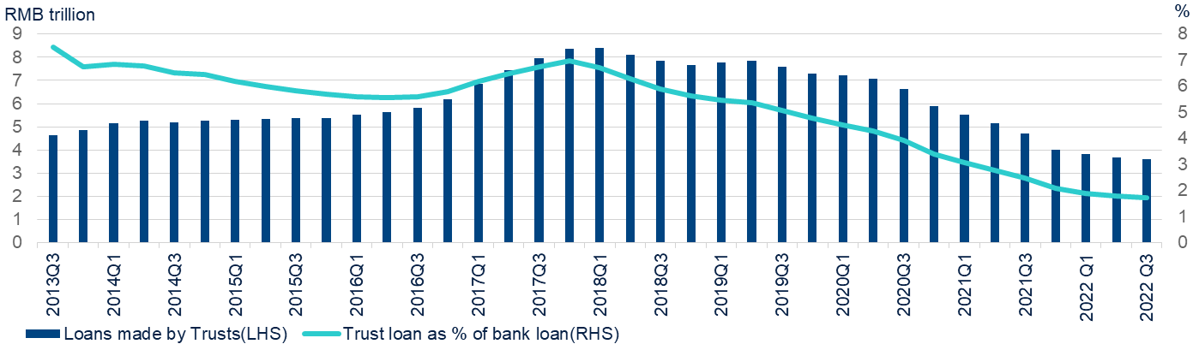
Contraction in trust loans continues
TRUST COMPANY LOANS CONTINUED TO DECLINED
Source: China Trustee Association & BBVA Research
The fast contraction in trust loans reflected the rising risks of real estate sector. Trust companies were scrambling to reduce their credit exposure to property developers.

Slide 41
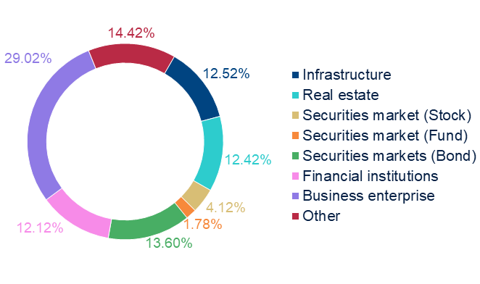
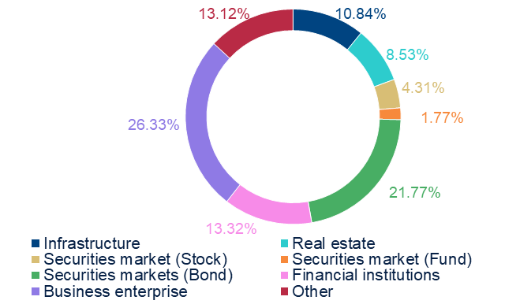
Trust assets pivoting away from infrastructure and real estate to bond market
AUTHORITIES PUT STRICT MONITOR ON THE FINANCING CHANNEL FOR INFRASTRUCTURE AND REAL ESTATE
Source: China Trustee Association & BBVA Research
Source: China Trustee Association & BBVA Research
Despite the shrinking size of trust loans to real estate and infrastructure, the downturn in the real estate sector still poses significant credit risks to trust firms.

Slide 42
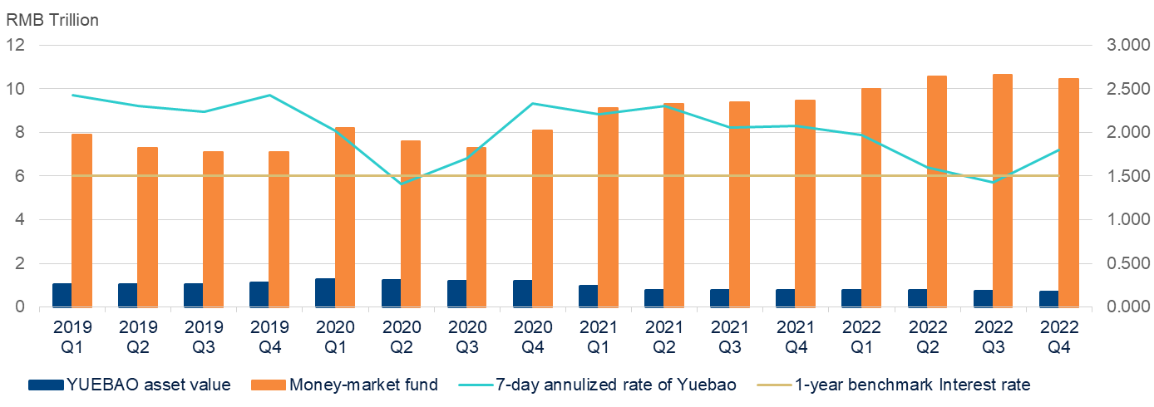
Money market funds attract massive capital inflow amid weak investment
Source: Wind & BBVA Research
Although returns on money market funds fell substantially in 2022, the total value rose to RMB 10.5 trillion by end-2022. It reflected investors’ strong preference for short-term and safe investment instruments under an highly uncertain environment.

Slide 43
Key regulatory developments in 2022
Date | Key regulatory developments
22-Jan | The CBRC issued the "Measures for the Management of Project Companies of Financial Leasing Companies", which regulats that financial leasing companies will need to carry out financial leasing business in the form of project companies, clarify the business scope of project companies and improve management systems and mechanisms.
22-Jan | The SFC has issued the "Interim Provisions on the Supervision of Important Money Market Funds (Draft for Comments". The "Interim Provisions" impose more stringent and prudent requirements on a number of indicators for important money market funds, including: leverage ratio, single issuer/investor, concentration, the proportion of specific assets, and a minimum percentage of holdings high-quality assets with high liquidity, etc.
22-Feb | The CBRIC issued the " Administrative Measures for Trust Industry Protection Funds and Liquidity Mutual Funds (Draft for Comments)", proposing new measures for the Trust Industry Protection Fund. One of the key adjustments is the simultaneous establishment of two parallel funds, including a newly trust industry protection fund (the "New PPF") and the original subscription-based fund remnamed as the "Liquidity Mutual Fund". The New PPF will provide relief to trust companies facing general liquidity risk to help them resume normal operations. The latter, in turn, will continue to be available to trust companies seeking short-term liquidity support in response to operational risks and liquidity stress.
22-Apr | The CBRIC has issued a Notice on Matters Relating to the Adjustment of the Classification of Trust Business, which proposes that trust business will be divided into three main categories: asset management trusts, asset servicing trusts and public welfare/charitable trusts. The new classification will excludes financing-related trust business. The new framework will help clarify the direction of trust business transformation.
22-Jun | The Ministry of Finance issued the "Regulations on Accounting Treatment Related to Asset Management Products", which has come into effect from 1 July 2022. The new regulations will unify the accounting treatment methods related to most asset management products in the market and raise the standard of overall financial instruments.
22-Jul | The CBIRC issued the "Measures for Capital Management of Financial Asset Investment Companies (Trial)". The main provisions include the calculation of Tier 1 and Tier 2 capital adequacy ratios, measurement of risk-weighted assets, calculation of leverage ratio and internal capital adequacy assessment procedures.
22-Jul | The CBIRC issued "Further Notice on Regulation of Commercial Banks' Internet Lending Business", in order to further regulate the online lending business of commercial banks, and promote the stable and healthy development of online lending.
22-Aug | The CBIRC issued the "Regulations on the Administration of Insurance Asset Management Companies, effective from 1 September 2022, which treat domestic and foreign insurance company shareholders of insurance asset management companies equally, remove the upper limit of foreign ownership and set conditions for uniform application.
22-Aug | The PBOC, together with the National Development and Reform Commission, the Ministry of Finance, the CBRIC and the SFC, jointly issued the "Notice on Promoting the Healthy Development of the Credit Rating Industry in the Bond Market", which came into effect on 1 September 2022. The new regulations recommend that credit rating agencies to establish quality assessment mechanisms and conduct cross-validation in order to improve credit rating standards.
22-Aug | Following the release of the consultation draft on 29 April 2022, the CBRIC issued the "Measures on Internal Control of Wealth Management Companies" to enhance management. The new regulations require wealth management companies to establish a prudent internal control management mechanisms and organisational structures, covering various business and management activities. A comprehensive assessment will be conducted at least once a year.
23-Mar | The "two sessions" announced to establish the super regulator for the financial sector-National Financial Regulatory Administration to replace and unify the previous China Banking and Insurance Regulatory Commission (CBIRC), consolidating financial system regulation and oversight, which aimed at closing loopholes with multiple agencies monitoring different aspects of financial industry.The setting up of the new super financial regulatory body comes as the authorities seeks to rein in large corporate and financial institutions that may bring systemic financial risks through regulatory arbitrage among previous multiply authorities.
Source: Moody, Government Work Report & BBVA Research

Slide 44
Disclaimer
This document has been prepared by BBVA Research Department. It is provided for information purposes only and expresses data, opinions or estimations regarding the date of issue of the report, prepared by BBVA or obtained from or based on sources we consider to be reliable, and have not been independently verified by BBVA. Therefore, BBVA offers no warranty, either express or implicit, regarding its accuracy, integrity or correctness.
Any estimations this document may contain have been undertaken according to generally accepted methodologies and should be considered as forecasts or projections. Results obtained in the past, either positive or negative, are no guarantee of future performance.
This document and its contents are subject to changes without prior notice depending on variables such as the economic context or market fluctuations. BBVA is not responsible for updating these contents or for giving notice of such changes.
BBVA accepts no liability for any loss, direct or indirect, that may result from the use of this document or its contents.
This document and its contents do not constitute an offer, invitation or solicitation to purchase, divest or enter into any interest in financial assets or instruments. Neither shall this document nor its contents form the basis of any contract, commitment or decision of any kind.
With regard to investment in financial assets related to economic variables this document may cover, readers should be aware that under no circumstances should they base their investment decisions on the information contained in this document. Those persons or entities offering investment products to these potential investors are legally required to provide the information needed for them to take an appropriate investment decision.
The content of this document is protected by intellectual property laws. Reproduction, transformation, distribution, public communication, making available, extraction, reuse, forwarding or use of any nature by any means or process is prohibited, except in cases where it is legally permitted or expressly authorised by BBVA on its website www.bbvaresearch.com.

Slide 45
This report has been produced by:
Chief Economist
Le Xia
le.xia@bbva.com
Betty Huang Economist betty.huang@bbva.com
ENQUIRIES TO: BBVA Research: Level 95, International Commerce Centre, Austin Road West, Kowloon, Hong Kong.
Tel. + 2582 3111 / Fax. +852-2587-9717 - bbvaresearch@bbva.com / www.bbvaresearch.com

Slide 46
China Banking Monitor
March 15, 2023

